Slide 1
Development of an AI Player for Tic-Tac-Toe
Ziad Mohamed 227631

Slide 2
Abstract
This project focuses on developing an AI player for Tic-Tac-Toe by integrating the Minimax algorithm with Alpha-Beta pruning and heuristic strategies. By applying heuristic search techniques, decision-making processes are optimized to enhance performance and efficiency. The primary goal is to create an AI capable of competing against human players in various conditions, understanding of game dynamics and adaptive gameplay.

Slide 3
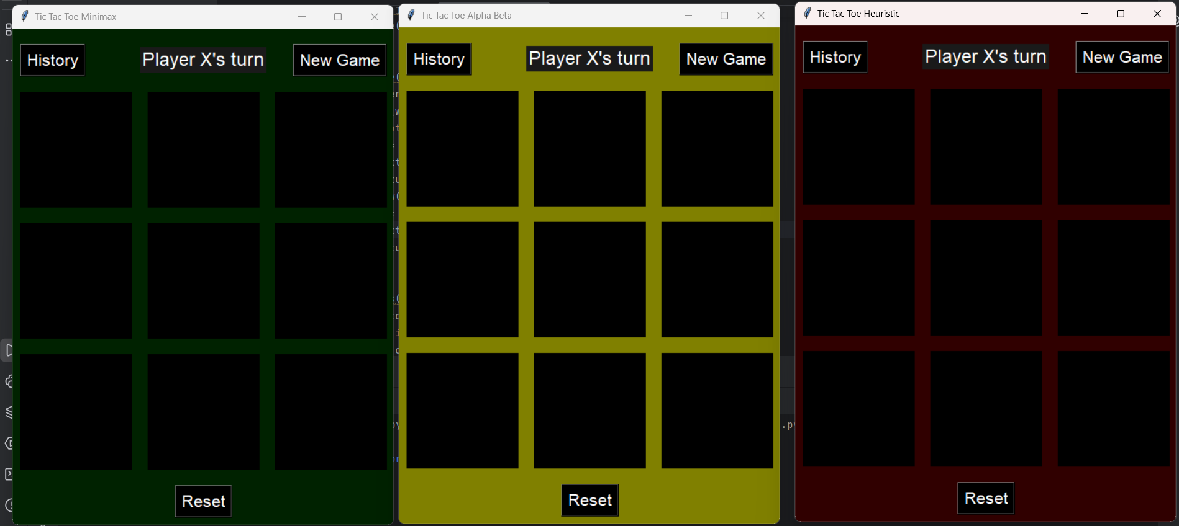
Objectives
Develop an AI player for Tic-Tac-Toe.
Integrate the Minimax algorithm with Alpha-Beta pruning and heuristic strategies.
Optimize decision-making processes to enhance performance and efficiency.
Enable the AI player to compete effectively against human players in many conditions.
Make AI understands with the game dynamics

Slide 4
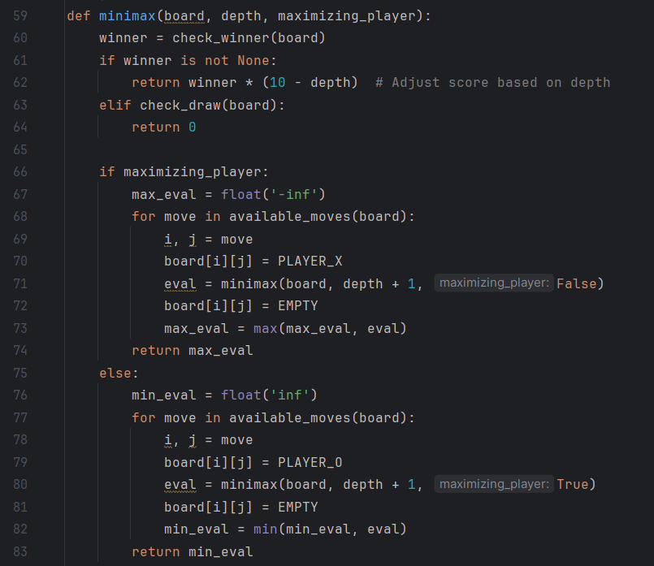
Minimax algorithm
Functionality:
The Minimax algorithm serves as the core logic for our AI player in Tic-Tac-Toe.It operates through recursive evaluation, maximizing and minimizing scores, and decision-making processes.
Recursive Evaluation:
The algorithm conducts a recursive search on the game tree. It evaluates all possible moves and their expected outcomes until reaching a terminal state or a specified depth.

Slide 5
Minimax algorithm
Maximizing and Minimizing Scores:
If it's the AI's turn, the algorithm aims to maximize the score, assuming optimal moves.
If it's the human’s turn, the algorithm minimizes the score, assuming the player makes the best possible move.
Decision-Making:
The AI selects the move that leads to the best score at the current level of the game tree.
This ensures strategic gameplay and competitive decision-making against human players.

Slide 6
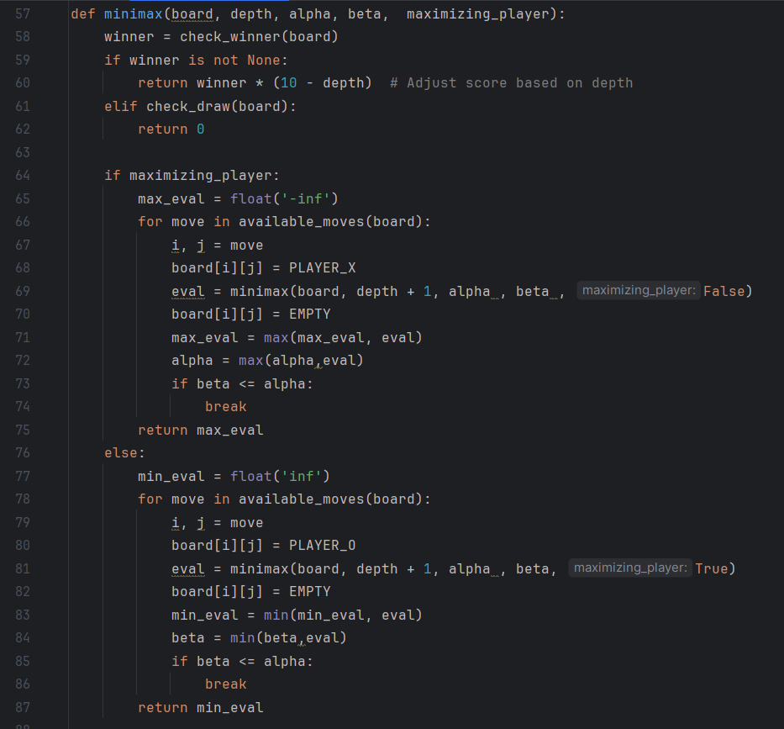
Integrated alpha beta pruning with Minimax algorithm
Alpha-Beta pruning optimizes the decision-making process by reducing unnecessary exploration of branches in the game tree.
It achieves this by eliminating branches that are known to be not needed to the final decision

Slide 7
Integrated alpha beta pruning with Minimax algorithm
During the Minimax algorithm's execution, Alpha-Beta pruning updates two values, alpha and beta, representing the best-known values for the maximizing and minimizing player, respectively.
If at any point, a branch's score falls outside the range defined by alpha and beta, that branch can be pruned because it will not affect the final decision.
By pruning irrelevant branches early in the search process, Alpha-Beta pruning significantly reduces the number of nodes evaluated, leading to faster decision-making without compromising accuracy.

Slide 8
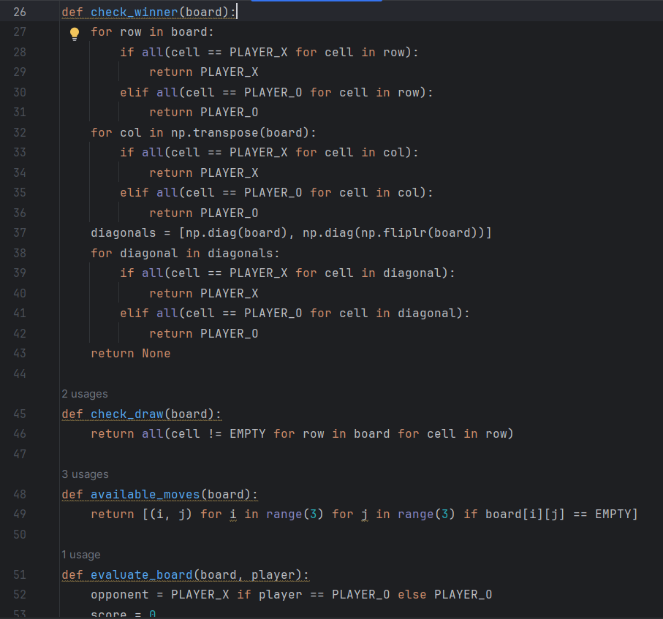
Integrated Heuristic Search Techniques with Minimax algorithm
Heuristic search techniques are integrated into the AI player to enhance decision-making in Tic-Tac-Toe.
Heuristic search offers quick evaluations of game states to prioritize more promising branches of the game tree.

Slide 9
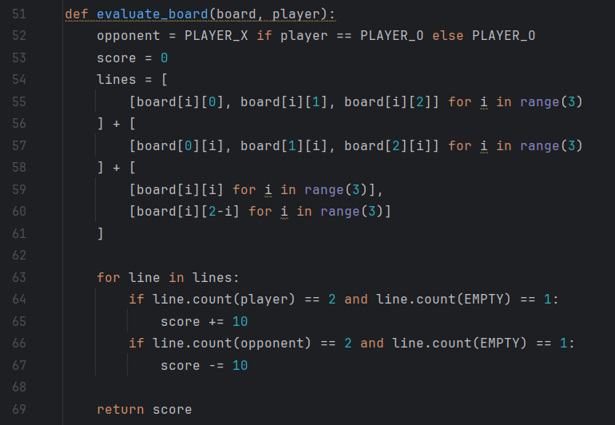
Integrated Heuristic Search Techniques with Minimax algorithm
Heuristic functions provide approximate evaluations of game states based on predefined rules or patterns.
By heuristic evaluations, the AI player can focus on relevant branches of the game tree, leading to faster decision-making and more intelligent.

Slide 10
Comparison between performance/ efficiency / adaptability
Minimax algorithm | Minimax algorithm with Alpha Beta pruning | Minimax algorithm With Heuristic search
Performs a complete search of the game tree, ensuring optimal move selection | Utilizes Alpha-Beta pruning to eliminate unused branches in the tree. | Integrates heuristic evaluations to approximate game states.
High used time, especially in games with a lot of possible moves. | More efficient than standard Minimax by reducing the number of evaluated nodes. | Focuses on more promising branches of the game tree, leading to faster decision times.
Limited adaptability to varying game complexities | Offers some adaptability and is suitable for complex game trees. | Highly adaptable to various game scenarios, considering the current state of the game.

Slide 11
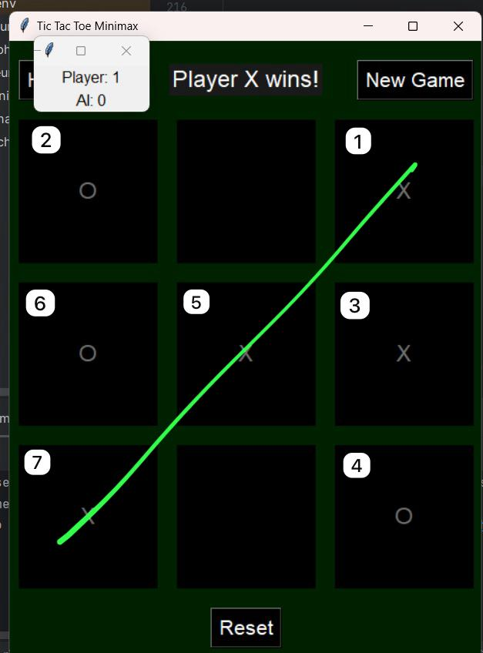
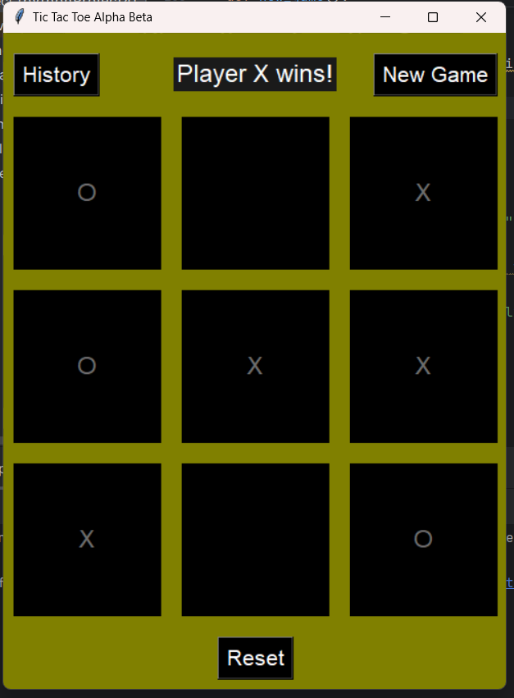
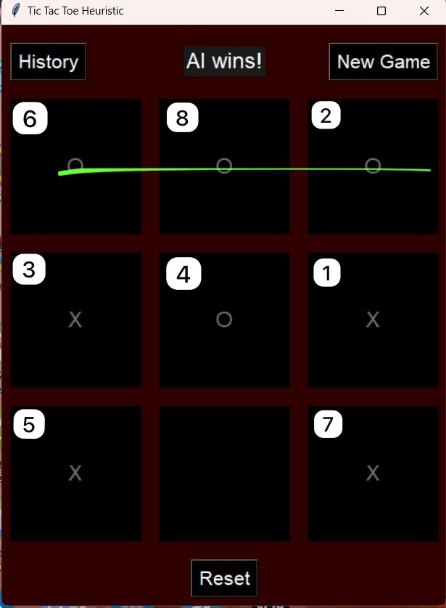
Testing and Scenarios
Various testing scenarios were conducted to evaluate the AI player's performance in Tic-Tac-Toe.
Scenarios:
Testing against different opponent strategies.
Evaluating performance under specific starting positions.
Assessing decision-making with varying search depths.
Analysis:
Each scenario provided insights into the AI player's strengths, weaknesses, and overall performance.

Slide 12
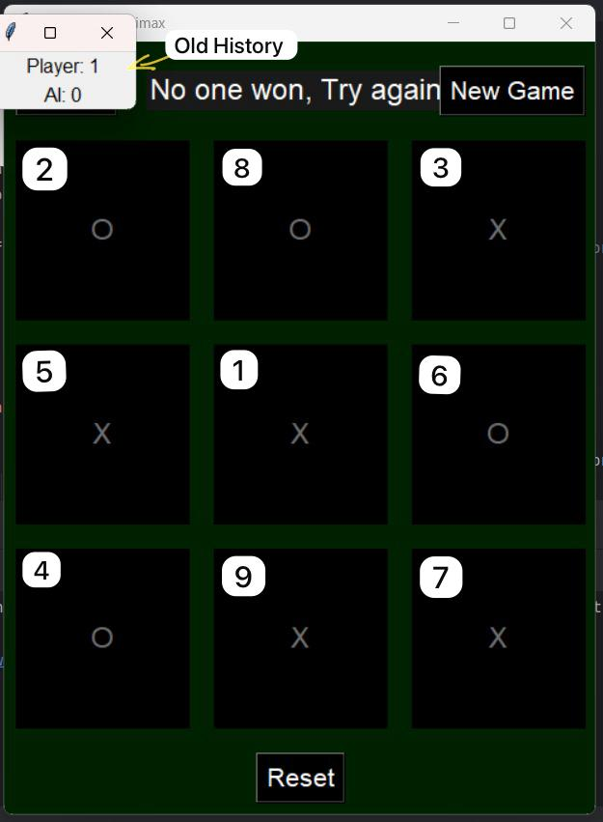
Quantitative Results
Minimax
Nodes Processed: Processes every possible move in the game tree.
Time Taken: Longest, due to exhaustive searching.
Minimax with Alpha-Beta Pruning
Nodes Processed: Fewer than standard Minimax due to pruning inefficient branches.
Time Taken: Reduced significantly compared to standard Minimax, dependent on move ordering.
Minimax with Heuristic Function:
Nodes Processed: Fewest among the three.
Time Taken: Shortest, thanks to efficient heuristic evaluations leading to quick decisions.

Slide 13
Qualitative Results
Minimax:
Accuracy (High): Finding the optimal move, leading to a win or a draw if possible.
Minimax with Alpha-Beta Pruning:
Accuracy (High): Maintains the same optimal decision-making as standard Minimax.
Minimax with Heuristic Function:
Accuracy (High): Unbeatable, always finds either a winning move or results in a draw.
No one can beat him!

Slide 14
Conclusion
In our project, we enhanced the Minimax algorithm for Tic Tac Toe by integrating Alpha-Beta pruning and heuristic functions. This optimized the AI's decision-making, making it faster and smarter. Alpha-Beta pruning allowed the AI to ignore less important moves, while heuristics enabled it to adapt and make more intelligent decisions based on the current game state. These improvements significantly improved the AI's performance. Looking forward, we aim to further develop the AI to learn and improve during gameplay

Slide 15
Thank You!

